Slide 1


Predicting Rainfall with Machine Learning
This presentation outlines a machine-learning approach to weather prediction. The core objective of this project is to accurately forecast rainfall by leveraging various classification models. We'll cover each critical step of the workflow, from initial data collection and preprocessing to exploratory data analysis and, ultimately, comprehensive model evaluation. Our aim is to build a robust and reliable system that provides timely and accurate rainfall predictions. Let's begin by exploring the data collection process!
by Sankari C

Slide 2
Project Workflow
Data Collection
1
Gathering weather data from reliable sources such as meteorological stations, radar systems, and satellite imagery to ensure a comprehensive dataset.
2
Exploratory Data Analysis (EDA)
Understanding data patterns, distributions, and potential relationships between variables through visualization techniques and statistical analysis.
Data Preprocessing
3
Cleaning and preparing data for modeling by handling missing values, removing outliers, and transforming features to improve model performance.
4
Model Training
Training various machine learning models, tuning hyperparameters, and cross-validating to optimize predictive accuracy and prevent overfitting.
Prediction & Evaluation
5
Predicting rainfall using the trained models, evaluating model performance using appropriate metrics, and refining the models based on the results.

Slide 3
Data Collection & Preprocessing
Loading the Dataset
Cleaning the data
Handling Missing Values
Converting categorical columns
Load data using pandas.
Remove whitespace
Filling missing data using the mode and median.
Transforming into numerical form for model compatibility.

Slide 4

Exploratory Data Analysis (EDA)
Statistical Measures
Distribution Analysis
Calculate descriptive statistics to understand data distribution.
Histograms to visualize feature distributions.
Correlation Matrix
Heatmap to identify feature correlations.

Slide 5
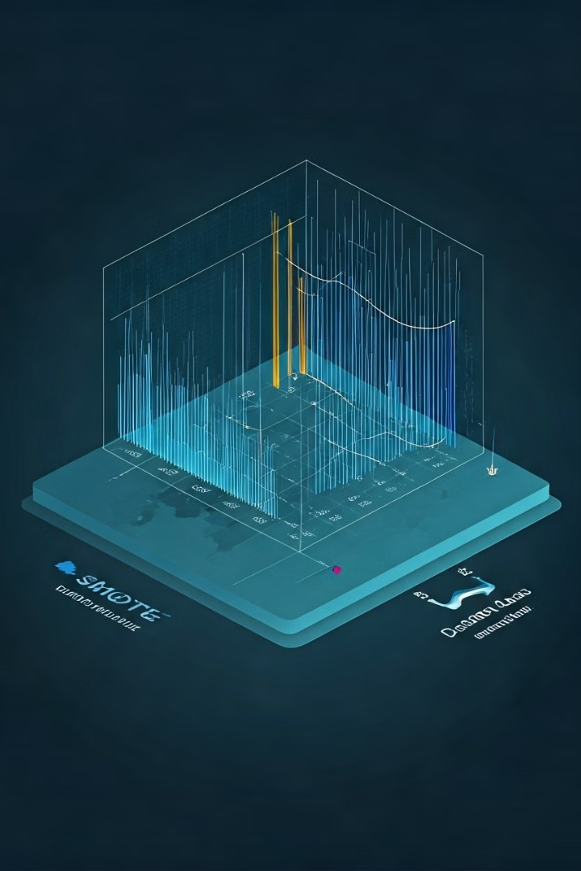


Addressing Data Imbalance
Targeted Data Analysis
SMOTE Oversampling
Utilizing SMOTE to balance the dataset.
Recognizing the imbalanced nature of rainfall data.
Balanced Data
Ensure even data representation.

Slide 6




Splitting and Shuffling Data
Feature and Target Separation
Splitting the dataset into features and target variables.
Data Shuffling
Improve model performance by shuffling data randomly.
Training and Testing Split
Dividing the data for training and evaluation.

Slide 7



Logistic Regression
Hyperparameter Tuning
Accuracy
0.79 accuracy score with Logistic Regression.
Logistic Regression employed with hyperparameter tuning. Achieved an accuracy score of 0.79. This model provides a baseline for comparison.

Slide 8



XGBoost Classifier
Tuning
Hyperparameter tuning is crucial for optimizing XGBoost. Techniques such as grid search or randomized search are used to find the best combination of parameters to enhance model performance.
2
Implementation
Implementing the XGBoost Classifier involves setting up the model with initial parameters and preparing it for training. Key steps include defining the objective function and evaluation metrics.
1
Evaluation
Evaluating the XGBoost model involves using appropriate metrics like accuracy, precision, recall, and F1-score. These metrics help to quantify the model's performance on the test dataset and identify areas for improvement.
3
XGBoost Classifier model improved accuracy. Achieved a score of 0.81, a notable improvement. XGBoost demonstrates better performance.

Slide 9
SVC Model Performance
SVC Model
1
Implementation and Configuration
Lowest Accuracy Score
2
Achieving only 0.49
Unsuitable for Prediction
3
Limitations in capturing rainfall patterns
The SVC (Support Vector Classifier) model yielded the lowest accuracy score of 0.49, making it unsuitable for reliable rainfall prediction. This poor performance highlights the limitations of SVC in capturing the complex, non-linear relationships inherent in rainfall data. Further investigation into model parameters or alternative algorithms is necessary for improved predictive accuracy.

Slide 10



Prediction System
Data
1
Collection and preprocessing of weather data, including temperature, humidity, pressure, and wind speed, to ensure data quality and relevance.
Model
2
Employ advanced machine learning algorithms such as XGBoost and Logistic Regression, fine-tuned for optimal predictive accuracy based on historical rainfall patterns.
Prediction
3
Generate accurate rainfall forecasts with quantified probabilities, aiding in effective planning and resource allocation for weather-sensitive operations and decision-making.
We have developed a comprehensive prediction system for rainfall, utilizing advanced machine learning techniques. By inputting relevant weather data, the system generates accurate rainfall predictions, enabling proactive planning and decision-making. This provides valuable, actionable weather insights for various applications.

